Slide 1
SENTINEL / MODEL 1 + MODEL 2
Trace the vehicle.
Show the proof.
An evidence-first vehicle journey system for Gujarat Police.
01
Notes:
An evidence-first vehicle journey system for Gujarat Police.
[Sources]
https://sentinel.gujarat.gov.in/problems
https://sentinel.gujarat.gov.in/resource
https://sentinel.gujarat.gov.in/faqs

Slide 2
The test is operational, not cosmetic
The officer’s task
What can go wrong
Enter the designated registration. Get the correct, time-ordered route quickly. Open the source evidence behind every material point.
A fast false match is worse than a visible gap. Arrival time can misorder events. A confident-looking route can hide weak plate evidence.
02
Notes:
The officer’s task: Enter the designated registration. Get the correct, time-ordered route quickly. Open the source evidence behind every material point.
What can go wrong: A fast false match is worse than a visible gap. Arrival time can misorder events. A confident-looking route can hide weak plate evidence.
[Sources]
https://sentinel.gujarat.gov.in/problems
https://sentinel.gujarat.gov.in/resource
https://sentinel.gujarat.gov.in/faqs

Slide 3
Model 1 + 2 gives the shortest credible path
Model 1: state truth
Model 2: direct evidence
One camera registry with health, ownership, source-system provenance, verified GIS, audit history and visible data gaps.
Consume departmental feeds without altering existing VMS or storage. Centralize sightings and selected evidence, not every pixel.
03
Notes:
Model 1: state truth: One camera registry with health, ownership, source-system provenance, verified GIS, audit history and visible data gaps.
Model 2: direct evidence: Consume departmental feeds without altering existing VMS or storage. Centralize sightings and selected evidence, not every pixel.
[Sources]
https://sentinel.gujarat.gov.in/problems
docs/hld.md
docs/model-selection.md

Slide 4
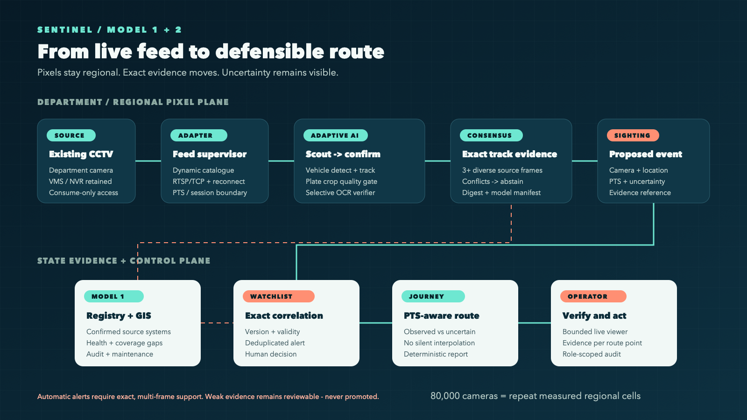
One workflow from catalogue to action
Every stage has one job
Discover dynamically. Decode once. Keep one exact scout bundle warm; lazy-load one specialist verifier. Exact multi-frame evidence may alert. Verifier failure suppresses the sighting. Route points retain source time and provenance.
04
Notes:
Every stage has one job: discover dynamically, decode once, keep one exact scout bundle warm, and lazy-load one specialist verifier. Both OCR paths must independently pass the temporal gate and agree exactly before an automatic sighting. Failure or disagreement becomes review, never an alert. Route points retain source time and provenance.
[Sources]
https://sentinel.gujarat.gov.in/resource
output/diagrams/sentinel-workflow.svg
docs/hld.md
docs/two-camera-acceptance.md

Slide 5
Accuracy comes from track evidence, not one frame
FIND
CONFIRM
ACT
Scout cheaply
Fuse the track
Alert or abstain
Low-rate tracking preserves coverage. Licensed holdout: 3 of 7 exact automatically.
Fuse sharp, diverse crops. Target search plus review reached 5 of 7.
Exact evidence alerts; reviewed evidence only routes. Zero unsafe or duplicate automatic identities.
05
Notes:
The current 1920x1080 policy was measured on six licensed road clips containing seven reviewer-readable identities. Three of seven were recovered automatically; exact target search plus review made five of seven reachable. Conditional authoritative precision was 1.0, with zero unsafe identities and zero duplicate automatic identities. Across 35 negative target-camera pairs, no false exact target match was found. This is a small licensed holdout, not government-feed or population accuracy.
[Sources]
output/benchmarks/licensed-full-frame-current-production-macbook-2026-08-31.json
output/benchmarks/licensed-target-review-current-production-macbook-2026-08-31.json
docs/anpr-benchmark.md

Slide 6
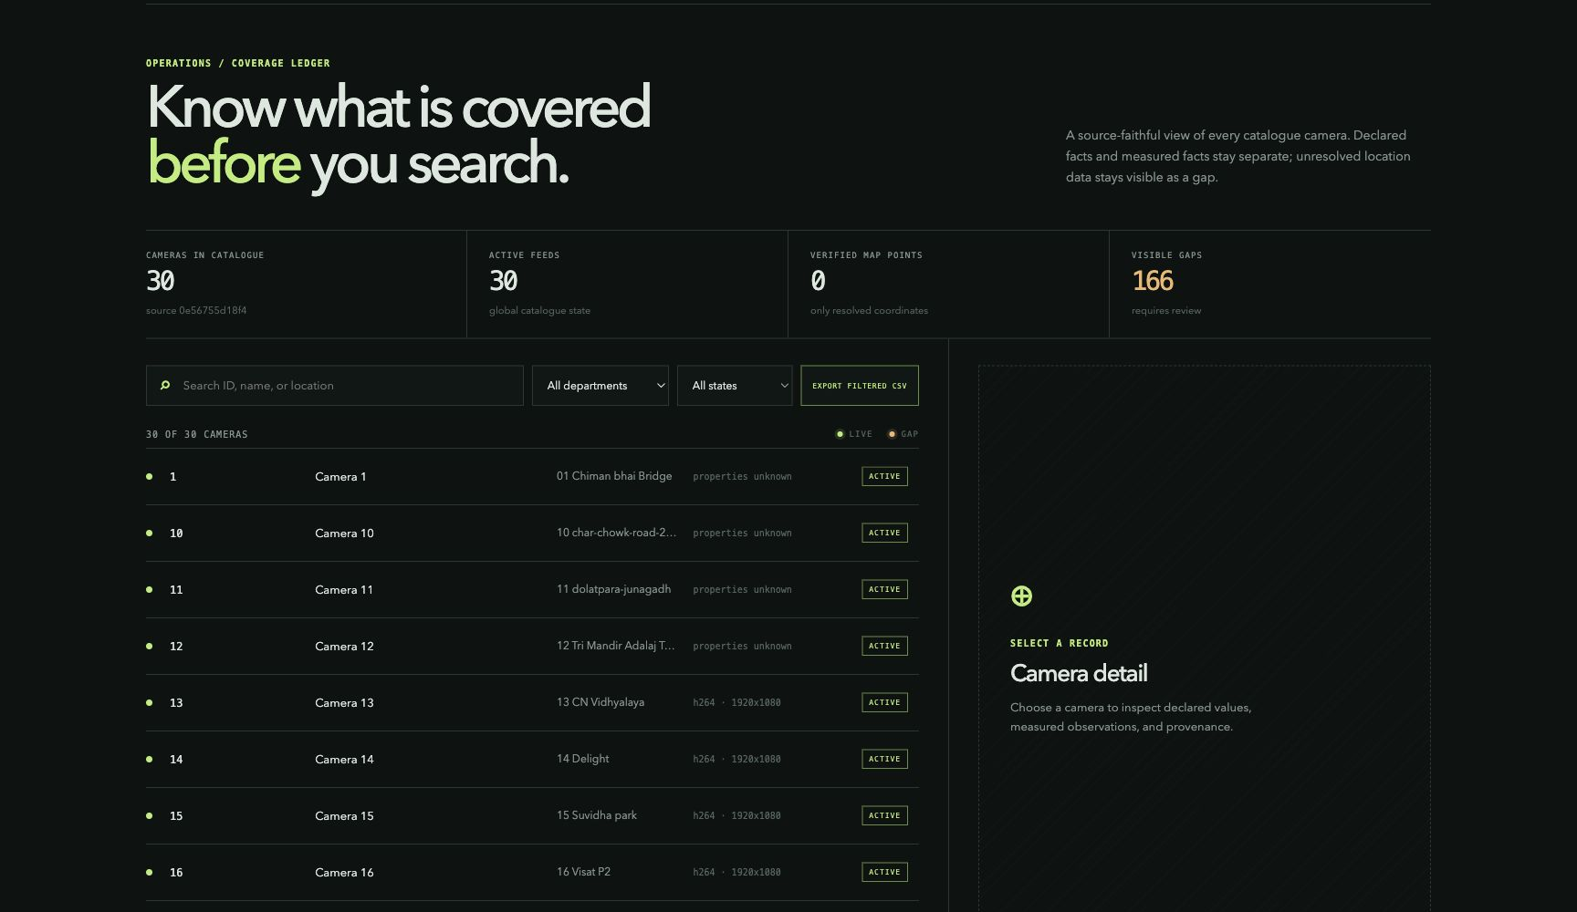
The working portal exposes gaps instead of inventing facts
A source-faithful operator surface
The last successful fresh run loaded 30 provided cameras. It showed 166 review items because department, source-system and GIS facts were unresolved. That honesty protects the route.
06
Notes:
The registry screenshot is from the working protected portal. The last successful fresh catalogue run loaded 30 provided cameras. The 166 review items are deliberate: department, source-system and verified GIS values were absent, so the system did not invent them.
[Sources]
output/screenshots/registry-portal-coverage-final.png
docs/sandbox-observations.md
docs/requirements-trace.md

Slide 7
The provided cameras have already shaped the system
Retained run: 14 cameras, 32 model jobs, zero runtime loss. Fresh same-build catalogue remains open.
14
32
0
official cameras delivered decoded frames in the integrated runtime
real model jobs completed on provided-camera frames
model failures, capacity drops or stale drops in that retained run
07
Notes:
At 2026-08-30T17:19:07Z, the integrated platform ran against a fresh 30-camera provided catalogue. Fourteen distinct official cameras delivered decoded frames and 32 real model jobs completed with zero model failures, capacity drops or stale drops. RTSP remained unreachable and HLS was intermittent, producing visible degraded coverage. At 2026-08-31T02:27:00Z the current build started another fresh catalogue gate, but the catalogue was unavailable and the run stopped before media or inference. No cached catalogue or government-feed success claim was used.
[Sources]
output/benchmarks/official-live-platform-macbook-2026-08-30.json
output/benchmarks/official-feed-soak-current.json
docs/sandbox-observations.md

Slide 8
Spend compute only where evidence can improve
Measured on 32 provided-camera model jobs; wall latency is p50 / p95.
170 / 431
22.8 / 49.4
4.1 / 9.7
vehicle detection · milliseconds
plate localization · milliseconds
scout OCR · milliseconds
08
Notes:
The retained integrated provided-camera run completed 32 model jobs. Warm sampled stage latency was vehicle detection 170.161/431.474 ms p50/p95, plate localization 22.811/49.352 ms, and scout OCR 4.078/9.706 ms. These are stage wall-latency distributions, not accuracy or statewide throughput claims. Preserving 1920x1080 input on the licensed holdout increased selected specialist crops from 38 to 142, so the specialist remains bounded and demand-loaded instead of running on every frame.
[Sources]
output/benchmarks/official-live-platform-macbook-2026-08-30.json
output/benchmarks/licensed-full-frame-current-production-macbook-2026-08-31.json
docs/anpr-benchmark.md

Slide 9
State scale comes from regional cells, not one video lake
Regional pixel plane
State evidence plane
One active decode owner per camera. Bounded queues drop stale work. Existing departmental storage remains authoritative. Cells scale by camera assignment.
At 80,000 cameras, 1–2 Mbit/s central copies mean 80–160 Gbit/s and 0.864–1.728 PB/day before replication. Searchable metadata stays central.
09
Notes:
Regional pixel plane: One active decode owner per camera. Bounded queues drop stale work. Existing departmental storage remains authoritative. Cells scale by camera assignment.
State evidence plane: At 80,000 cameras, 1–2 Mbit/s central copies mean 80–160 Gbit/s and 0.864–1.728 PB/day before replication. Searchable metadata stays central.
[Sources]
https://sentinel.gujarat.gov.in/problems
docs/hld.md
docs/sizing.md

Slide 10
Interoperability and security share the same boundary
Replaceable adapters
Least privilege
The catalogue is the contract. RTSP/TCP serves inference; WHEP serves low-latency preview; HLS is a restricted-network fallback. Unknown organizer fields are preserved.
Consume only. Keep credentials memory-only. Scope search, evidence, watchlists, export and audit. Every correction is an event; raw evidence remains traceable.
10
Notes:
Replaceable adapters: The catalogue is the contract. RTSP/TCP serves inference; WHEP serves low-latency preview; HLS is a restricted-network fallback. Unknown organizer fields are preserved.
Least privilege: Consume only. Keep credentials memory-only. Scope search, evidence, watchlists, export and audit. Every correction is an event; raw evidence remains traceable.
[Sources]
https://sentinel.gujarat.gov.in/resource
docs/security-architecture.md
docs/hld.md

Slide 11
The live demo ends in one inspectable route
01 / ONBOARD
02 / TRACE
03 / VERIFY
Prove the feeds
Enter the plate
Open the proof
Sync fresh catalogue feeds through one persistent worker. Show mixed-codec recovery and visible gaps.
Find exact, source-timed sightings. Replay every retained point; prove idempotence and persistence.
Inspect source evidence, alert reason, PTS, model build and exportable route report.
11
Notes:
Prove the feeds: sync the current dynamic catalogue, process supplied feeds through one persistent worker, and show mixed-codec recovery plus visible degraded coverage.
Enter the plate: find exact source-timed sightings and prove idempotent persistence.
Open the proof: inspect source evidence, alert reason, PTS, model build and exportable route report.
The current 70.28-second own-feed recording demonstrates that exact operator path on licensed media. The government-feed capture remains a separate open gate.
[Sources]
https://sentinel.gujarat.gov.in/problems
https://sentinel.gujarat.gov.in/resource
output/video/sentinel-own-feed-demo-submission.mp4
docs/government-acceptance-run.md
docs/requirements-trace.md

Slide 12
THE DECISION
One route.
Every point has proof.
Evaluate the operator outcome: accuracy, evidence, latency and recovery under the same feeds.
12
Notes:
Evaluate the operator outcome: accuracy, evidence, latency and recovery under the same feeds.
[Sources]
https://sentinel.gujarat.gov.in/problems
docs/hld.md

