Slide 1
SENTINEL / MODEL 1 + MODEL 2
Trace the vehicle.
Show the proof.
An evidence-first vehicle journey system for Gujarat Police.
01
Notes:
An evidence-first vehicle journey system for Gujarat Police.
[Sources]
https://sentinel.gujarat.gov.in/problems
https://sentinel.gujarat.gov.in/resource
https://sentinel.gujarat.gov.in/faqs

Slide 2
The test is operational, not cosmetic
The officer’s task
What can go wrong
Enter the designated registration. Get the correct, time-ordered route quickly. Open the source evidence behind every material point.
A fast false match is worse than a visible gap. Arrival time can misorder events. A confident-looking route can hide weak plate evidence.
02
Notes:
The officer’s task: Enter the designated registration. Get the correct, time-ordered route quickly. Open the source evidence behind every material point.
What can go wrong: A fast false match is worse than a visible gap. Arrival time can misorder events. A confident-looking route can hide weak plate evidence.
[Sources]
https://sentinel.gujarat.gov.in/problems
https://sentinel.gujarat.gov.in/resource
https://sentinel.gujarat.gov.in/faqs

Slide 3
Model 1 + 2 is our selected submission path
Model 1: state truth
Model 2: direct evidence
One camera registry with health, ownership, source-system provenance, verified GIS, audit history and visible data gaps.
Consume departmental feeds without altering existing VMS or storage. Centralize sightings and selected evidence, not every pixel.
03
Notes:
Model 1: state truth: One camera registry with health, ownership, source-system provenance, verified GIS, audit history and visible data gaps.
Model 2: direct evidence: Consume departmental feeds without altering existing VMS or storage. Centralize sightings and selected evidence, not every pixel.
[Sources]
https://sentinel.gujarat.gov.in/problems
docs/hld.md
docs/model-selection.md

Slide 4
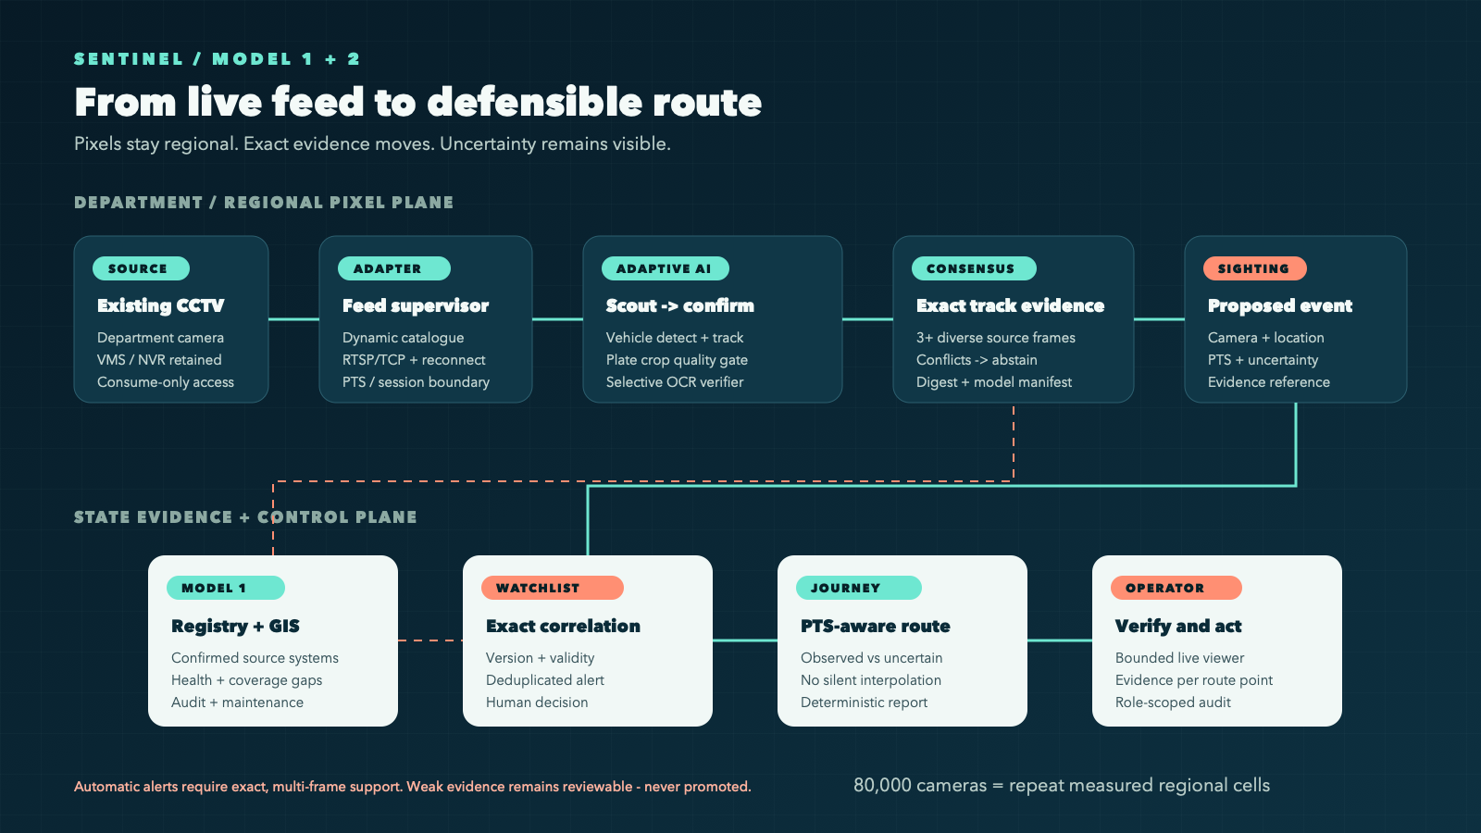
One workflow from catalogue to action
Every stage has one job
Discover dynamically. Decode once. Keep one exact scout bundle warm; lazy-load one specialist verifier. Exact multi-frame evidence may alert. Verifier failure suppresses the sighting. Route points retain source time and provenance.
04
Notes:
Every stage has one job: discover dynamically, decode once, keep one exact scout bundle warm, and lazy-load one specialist verifier. Plate work is capped at three active tracks per frame because that was the smallest measured budget that restored the mandatory sighting, alert and route outcome. Both OCR paths must independently pass the temporal gate and agree exactly before an automatic sighting. Failure or disagreement becomes review, never an alert. Route points retain source time and provenance.
[Sources]
https://sentinel.gujarat.gov.in/resource
output/diagrams/sentinel-workflow.svg
docs/hld.md
output/benchmarks/clean-start-recorded-demo-macbook-2026-08-31.json

Slide 5
Accuracy comes from track evidence, not one frame
FIND
CONFIRM
ACT
Scout cheaply
Fuse the track
Alert or abstain
Low-rate vehicle detection and tracking keep every served camera covered.
Rank sharp, diverse plate crops. OCR a few. Require exact temporal consensus.
Exact evidence may alert. Human-confirmed ambiguity may enter the route, never an automatic alert.
05
Notes:
Automatic alert authority stays strict: exact, multi-frame, cross-model agreement. Ambiguous OCR remains reviewable. If an authorized officer confirms retained evidence for the active designated target, the system may add that point to the route with explicit human-confirmed authority while withholding any automatic alert. A later rejection reverses the route projection without rewriting the source OCR record. The review semantics are tested, but the historical live-model review artifact is not claimed as current submission evidence.
[Sources]
docs/hld.md
docs/contracts.md

Slide 6
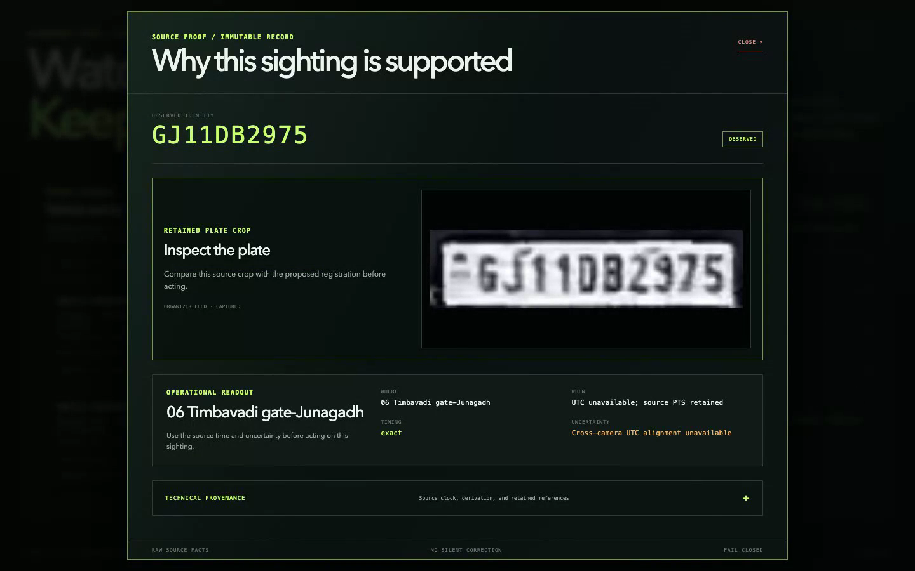
A government plate. Its original proof.
Open the crop. Check the claim.
Captured organizer evidence supports GJ11DB2975 at Timbavadi gate. The crop opens immediately. Source time is retained; missing UTC alignment stays visible.
06
Notes:
This current operator UI displays an immutable organizer-feed sighting captured on 2 September. It is not a new live observation. Exact source PTS is 198010 at 1/90000; event UTC and GIS coordinates remain unknown. The same crop is included in the dated report.
[Sources]
output/reports/government-snapshot-2026-09-05-final/report.json
output/screenshots/government-proof-2026-09-05.png

Slide 7
Provided feeds. Inspectable results.
Captured 2 September: events across 22 cameras; one supported sighting and three review candidates.
30
1,000
19
organizer cameras in the retained registry
real analysis events; not unique vehicle counts
retained crops with verified SHA-256 digests
07
Notes:
These are corpus counts, not accuracy or unique vehicles. The 1,000 analysis events consist of 927 vehicle detections and 73 plate-verification requests. Separately there are four sightings: one supported and three review candidates, all on cam06. Nineteen retained RGB crops passed byte count, dimensions and SHA-256 verification. No cross-camera route is asserted.
[Sources]
output/reports/government-snapshot-2026-09-05-final/report.json
output/corpus/government-provided-feed-2026-09-03/manifest-2026-09-02.json

Slide 8
Spend compute only where evidence can improve
Historical retained run; each card shows p50 range (line 1) / p95 range (line 2), milliseconds.
282–496
423–789
46–131
106–563
9–21
21–144
vehicle detection · milliseconds
plate localization · milliseconds
scout OCR · milliseconds
08
Notes:
Across the retained 506-job distributed run, per-cell vehicle-detection p50 ranged from 282.119 to 495.990 ms and p95 from 422.512 to 788.965 ms. Plate-localization p50 ranged from 46.119 to 130.945 ms and p95 from 105.609 to 562.856 ms. Scout-OCR p50 ranged from 9.368 to 20.562 ms and p95 from 20.851 to 144.120 ms. These are stage distributions across different hosts, not end-to-end operator latency, accuracy or statewide capacity.
[Sources]
output/benchmarks/government-distributed-fleet-30cam-2026-09-02.json
docs/real-feed-performance.md

Slide 9
State scale is planned, not yet measured statewide
Regional pixel plane
State evidence plane
One active decode owner per camera. Bounded queues drop stale work. Existing departmental storage remains authoritative. Cells scale by camera assignment.
At 80,000 cameras, 1–2 Mbit/s central copies mean 80–160 Gbit/s and 0.864–1.728 PB/day before replication. Searchable metadata stays central.
09
Notes:
Regional pixel plane: One active decode owner per camera. Bounded queues drop stale work. Existing departmental storage remains authoritative. Cells scale by camera assignment.
State evidence plane: At 80,000 cameras, 1–2 Mbit/s central copies mean 80–160 Gbit/s and 0.864–1.728 PB/day before replication. Searchable metadata stays central.
[Sources]
https://sentinel.gujarat.gov.in/problems
docs/hld.md
docs/sizing.md

Slide 10
Interoperability and security share the same boundary
Replaceable adapters
Least privilege
The catalogue is the contract. RTSP/TCP serves inference; WHEP serves low-latency preview; HLS is a restricted-network fallback. Unknown organizer fields are preserved.
Consume only. Keep credentials memory-only. Scope search, evidence, watchlists, export and audit. Every correction is an event; raw evidence remains traceable.
10
Notes:
Replaceable adapters: The catalogue is the contract. RTSP/TCP serves inference; WHEP serves low-latency preview; HLS is a restricted-network fallback. Unknown organizer fields are preserved.
Least privilege: Consume only. Keep credentials memory-only. Scope search, evidence, watchlists, export and audit. Every correction is an event; raw evidence remains traceable.
[Sources]
https://sentinel.gujarat.gov.in/resource
docs/security-architecture.md
docs/hld.md

Slide 11
One operator journey. Every claim opens its proof.
01 / ONBOARD
02 / TRACE
03 / VERIFY
Prove the feeds
Enter the plate
Open the proof
Sync the fresh catalogue. Show official preview, real inference and visible coverage gaps.
Licensed replay proves an alert and one timed point. The cross-camera test awaits the later feed set.
Inspect source evidence, alert reason, PTS, model build and exportable route report.
11
Notes:
The 5 September licensed replay and restart test prove one sighting, one proposed watchlist alert, three evidence crops, and no duplicate durable records. This is one-camera licensed media, not government recurrence. Palash clarified that the current provided set cannot support a two-camera journey; the later approximately 50 real cameras are the intended route acceptance set. This is a team clarification, not a published organizer promise. Model 2 still separately requires at least two provenance-confirmed source systems.
[Sources]
https://sentinel.gujarat.gov.in/problems
output/benchmarks/licensed-recorded-demo-durability-2026-09-05.json
docs/government-acceptance-run.md

Slide 12
THE DECISION
Route only with evidence.
Evaluate the operator outcome: accuracy, evidence, latency and recovery under the same feeds.
12
Notes:
Evaluate the operator outcome: accuracy, evidence, latency and recovery under the same feeds.
[Sources]
https://sentinel.gujarat.gov.in/problems
docs/hld.md

